Slide 1
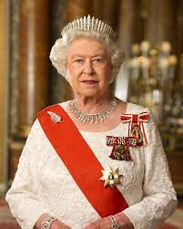
Queen Elizabeth II
(1926-2022)

Slide 2
Tables of contents
Elizabeth I VS Elizabeth II
The family
The birth
The childhood
Edward VIII
Second World War
Rebuilding of the country
Coronation
Commonwealth tours
Silver Jubilee
Margaret Thatcher
Queen Elizabeth and Margaret Thatcher
Princess Diana and Prince Charles
Prince Charles and Camilla
Brexit
Death of Queen Elizabeth

Slide 3
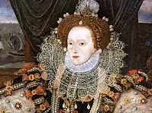
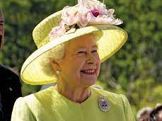
Elizabeth I vs Elizabeth II
Elizabeth I (1533-1603)
stability and prosperity
great period for literature (William Shakespeare; 1564-1616)
exploration: voyages led by many explorers (example: Sir Francis Drake circumnavigate the globe)
Elizabeth I
Elizabeth II

Slide 4
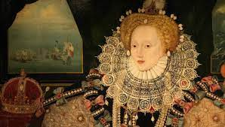
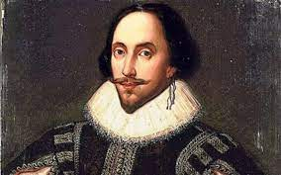
William Shakespeare
Queen Elizabeth I

Slide 5
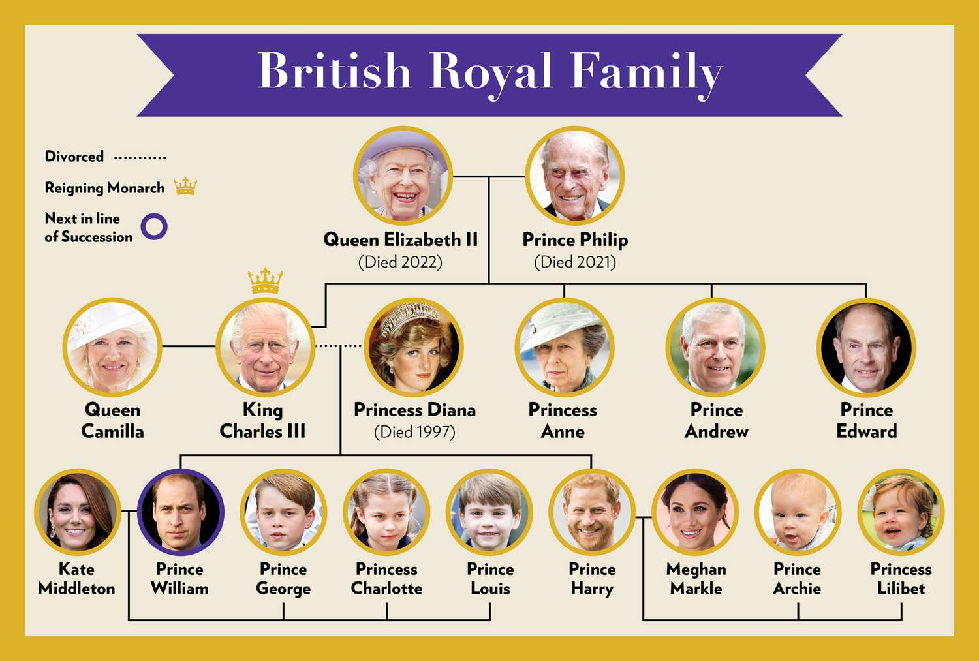
Queen Elizabeth II and her family tree

Slide 6
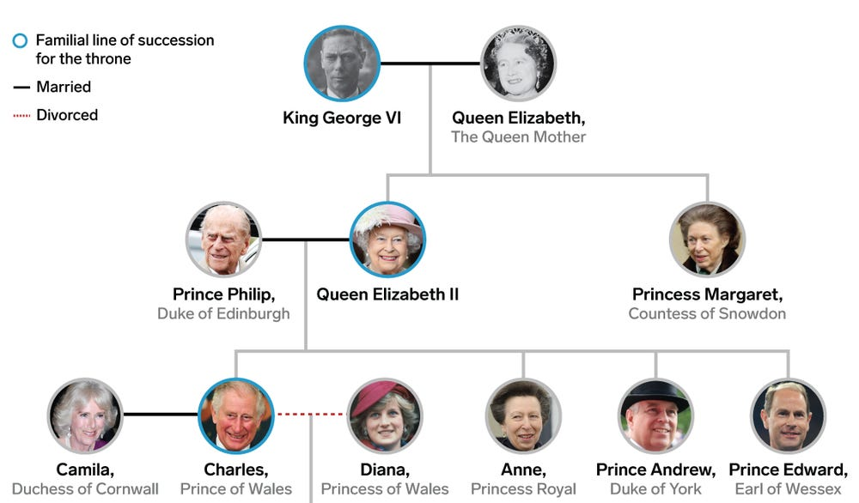
Family tree considering the past
Elizabeth II’s parents

Slide 7
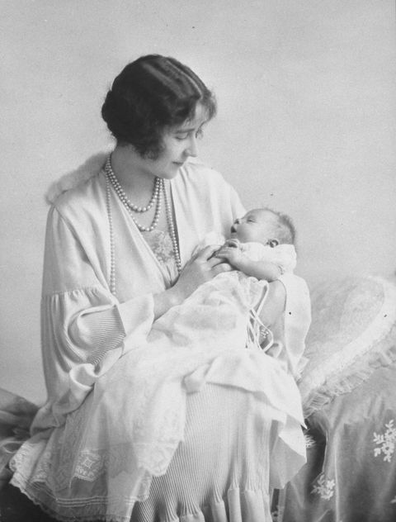
The birth
Born on the 21st April 1926
Named Elizabeth after her mother
Called “Lilibet” by her close family
Born when her father was not
a king yet!

Slide 8
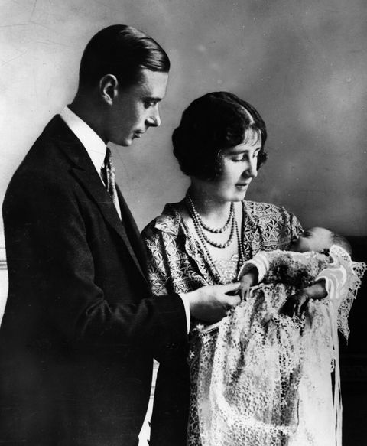
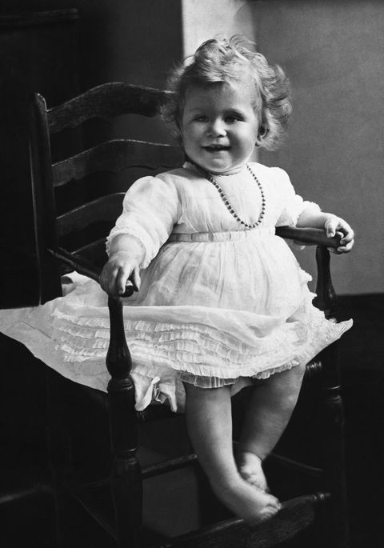
Elisabeth, her father and her
mother
When Elizabeth was a toddler

Slide 9
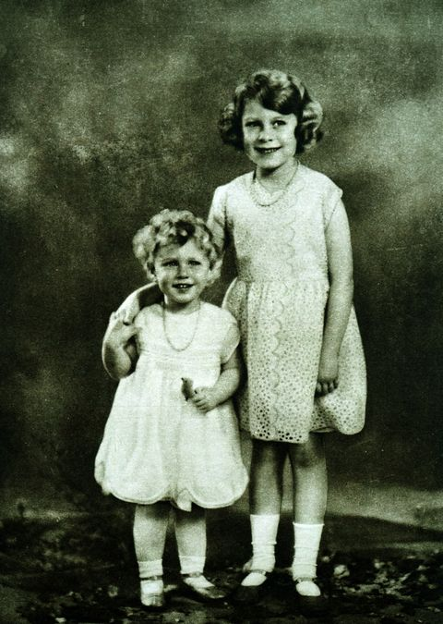
The childhood
Birth of her sister Margaret in 1930
The children were educated under
the supervision of their mother and the
governess (literature, history, music)
Elizabeth started to love horses and dogs
Elizabeth and her sister in 1932/1933

Slide 10
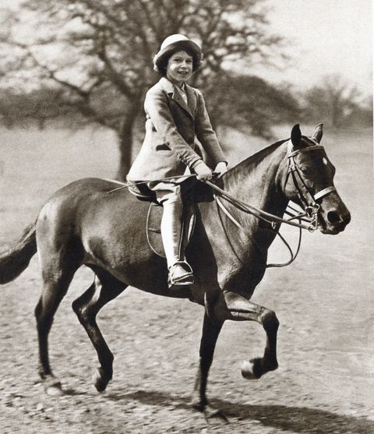
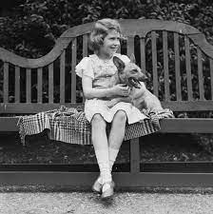
Elizabeth’s love of horses and dogs (1930s)

Slide 11
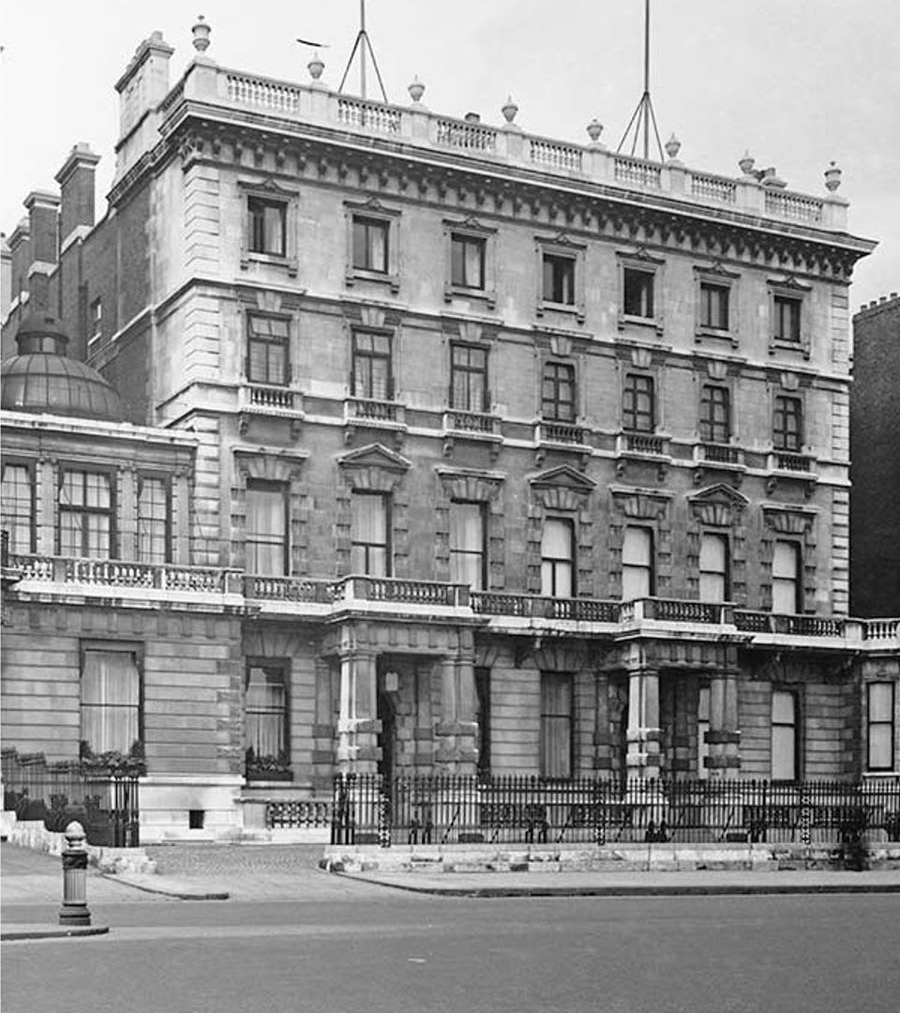
Elizabeth spent her childhood
in Piccadilly (London)
in the family’s town house

Slide 12
Edward VIII (1894-1972)
Queen Elizabeth was not expected to become a Queen!
Elizabeth’s grandfather (George V) died in 1936
Her uncle Edward VIII succeeded on the 20th January 1936
However
He abdicated on the 11th December 1936

Slide 13
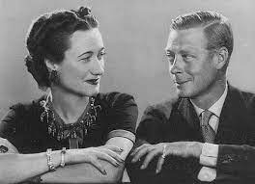
Why did Edward VIII abdicate?
In 1931 she met Ellis Simpson, an American woman who was married for the second time
Starting from 1934, Edward and Ellis became lovers
King Edward VIII and Ellis Simpson

Slide 14
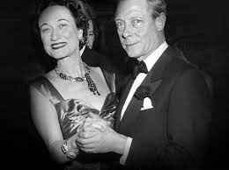
The fact that Ellis was:
- American
- divorced
was not accepted by the royal family!
In 1936, the king declared that he intended to marry Ellis Simpson
Thus, he decided to abdicate and refused to continue to be the king

Slide 15
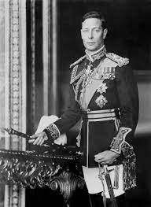
Second World War
After the abdication of the brother in 1936,
George VI (the father of Elizabeth) became
the king
In September 1939, Britain entered the
Second World War
George VI (1895-1952)

Slide 16

Britain fought together with:
- USA
- Russia
- Soviet Union
- other states such as Australia and New Zealand
Britain fought mainly against with:
- Germany
- Italy

Slide 17
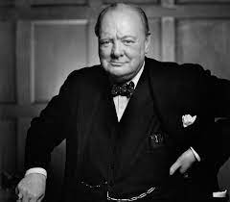
In 1940, Winston Churchill
became the Prime Minister
He was known for his strong leadership
and determination
Winston Churchill (1874-1965)

Slide 18
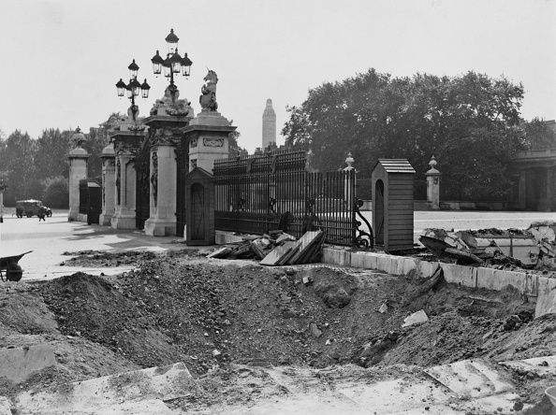
Buckingham Palace bombed in 1940 by German forces

Slide 19
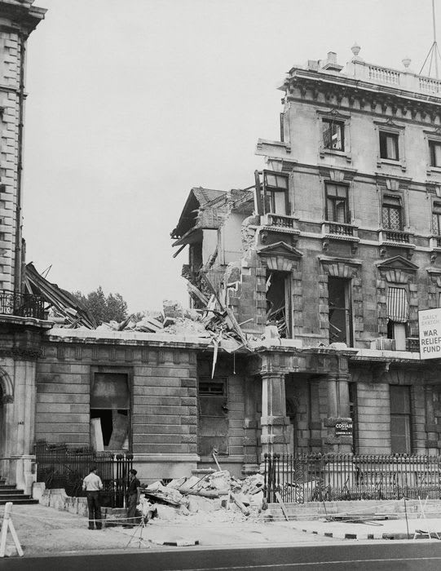
Unfortunately, also the family’s
town house was destroyed
during World War II
(where Elisabeth spent her childhood)
The family moved to
Royal Lodge, a royal building in
London

Slide 20
In 1940, when Elizabeth was only 14, she made her first public speech during the BBC “Children’s hour” to support the people’s morale:
“"We are trying to do all we can to help our gallant sailors, soldiers, and airmen, and we are trying, too, to bear our own share of the danger and sadness of war. We know, every one of us, that in the end all will be well.“
https://www.google.com/search?q=bbc+children%27s+hour+queen+elizabeth&rlz=1C1PASC_itIT1035IT1035&oq=bbc+children%27s+hour+quee&aqs=chrome.1.69i57j0i22i30.4725j0j7&sourceid=chrome&ie=UTF-8#fpstate=ive&vld=cid:cb4b6c5b,vid:VJI9LPFQth4

Slide 21
In 1944, Elizabeth was eighteen
She decided to sign up for the Auxiliary Territorial Service (the women’s branch of the British Army)
In 1945, she became the first woman in the Royal Family to become a full-time member of the armed services

Slide 22
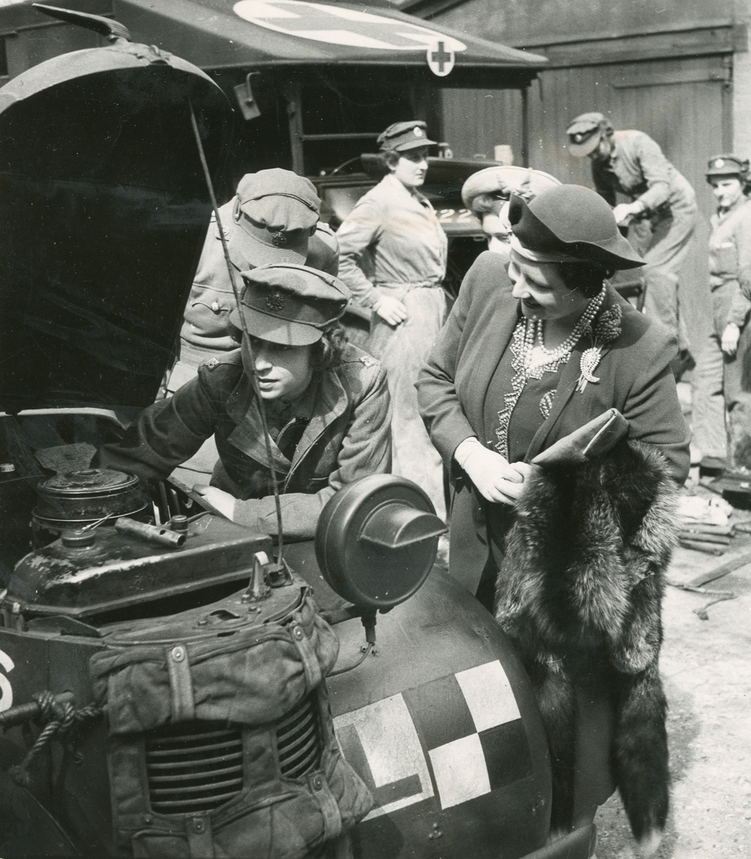
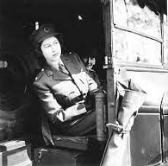
Elisabeth studied various subjects related to military service:
- vehicle maintenance
- mechanics
- map reading

Slide 23
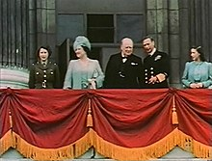
The end of the Second World War
War in Europe ended in May 1945
The Second World War ended in 2nd September 1945 with the surrender of Japan
8th May 1945, Princess Elisabeth, King George VI and Winston Churchill

Slide 24
Rebuilding of the country
In 1947, Princess Elizabeth went on her first overseas tour with her parents in South Africa
During the tour, she broadcasted an important speech of devotion to the country in her 21st birthday:
"I declare before you all that my whole life, whether it be long or short, shall be devoted to your service and the service of our great imperial family to which we all belong.“
https://www.youtube.com/watch?v=RUlToHE_27U

Slide 25
Before the WWII: the British Empire had colonies across the globe
Canada
the Caribbean,
Africa (Nigeria, Kenia, South Africa)
Asia (India and Singapore)
the Middle East (Egypt and Palestine)
Australia
New Zealand
After WWII, the British Empire declined! For this reason, the crown focused on rebuilding a unity and stability in Britain, needed by the poverty caused by the WIII and the decline of the British Empire

Slide 26
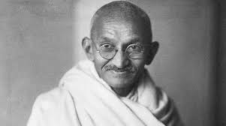
People in the colonies were inspired by the principles of freedom and independence promoted during the war, and they began pushing for their own autonomy
An example: independence of India (1947)
Mahatma Gandhi, one of the most important figure in the independence of India

Slide 27
The decline of the British Empire started in the late years of the 19th century and had its peak after WWII
For this reason, in 1926 the Commonwealth of Nations was established
=
It constitutes an intergovernmental organization to promote cooperation and dialogue among the British colonies and Britain
It still exists today!

Slide 28
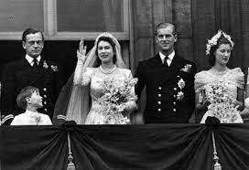
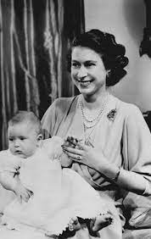
In 1947, Elizabeth married Prince Philip in Westminster Abbey
(At the beginning the marriage was criticised for the German
origins of Prince Philip)
In 1948, Elizabeth gave birth to her first child, Charles

Slide 29
Coronation
In 1952, when Princess Elizabeth and Prince Philip were in the British colony of Kenia, King George VI died
The coronation of Queen Elizabeth was done on 2nd June 1953 in Westminster Abbey
It was the first coronation televised!
https://www.youtube.com/watch?v=VhmR23MVY_g

Slide 30
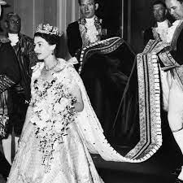
Coronation of Queen Elizabeth in 1953

Slide 31
Commonwealth tours
After her coronation, Queen Elizabeth II has undertaken numerous tours and visits to Commonwealth countries and other nations around the world to:
- strengthen diplomatic ties
- promote cultural understanding
- reinforce the bonds within the Commonwealth

Slide 32
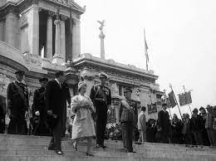
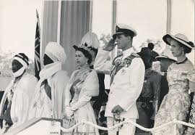
Royal family in Rome (1951)
Royal family in Nigeria (1956)

Slide 33
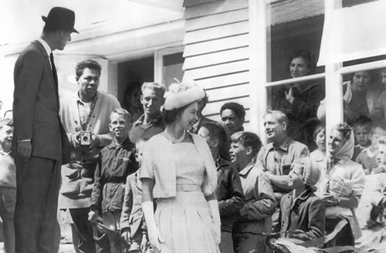
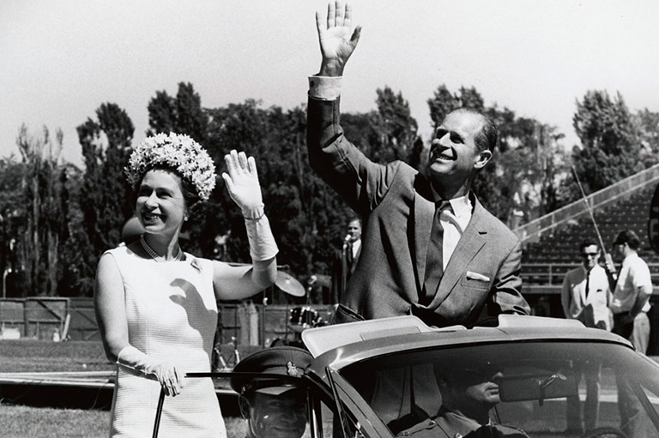
Royal family in New Zealand (1963)
Royal family in Canada (1967)

Slide 34
Silver jubilee
In 1977: celebration of Queen Elizabeth’s Silver Jubilee (25 years of reign)
The celebrations included various events and festivities held throughout the United Kingdom and across the Commonwealth

Slide 35
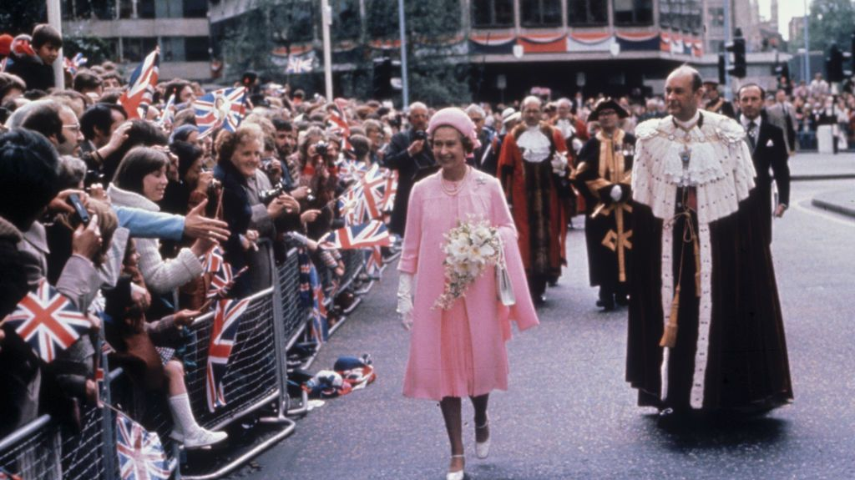

Slide 36
Queen Elizabeth II and the Prime Ministers
Queen Elizabeth was in continuous contact with the Prime Ministers of the UK
Prime Ministers had always been male until 1979

Slide 37
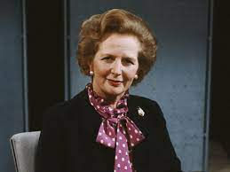
Margaret Thatcher (1925-2013)
Margaret Thatcher was the
Prime Minister of the UK from
1979 to 1990
Known as the “iron lady” for her determination and conservative policies
She has been the first woman to become the Prime Minister in the UK!

Slide 38
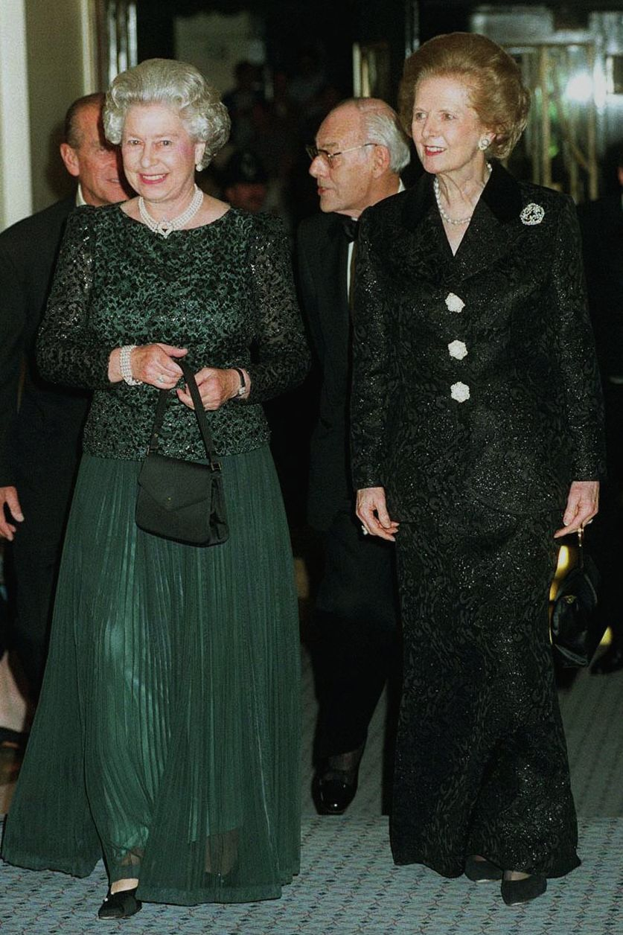
Queen Elizabeth and Margaret Thatcher
Thatcher implemented a series of economic reforms known as Thatcherism, which aimed to reduce the role of the state in the economy and promote free-market principles
The Queen and Thatcher encountered every week to discuss about the current issues
However, the relationship between the two women is often described as difficult and distant due to the determination of both

Slide 39
In 1973, the UK joined the European Union
Initially, Margaret Thatcher was in favour of remaining in EU, but during the 1980s she changed her mind, and she became Eurosceptic
Why?
She believed that EU was becoming
too centralised (in her opinion,
nations were losing their powers)

Slide 40
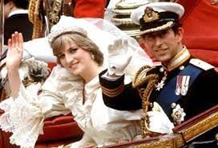
Princess Diana and Prince Charles
In 1981, Prince Charles got married with Princess Diana (known as Diana Spencer) in St. Paul Cathedral in London
However, over time, the couple faced challenges and experienced marital difficulties, leading to their separation and subsequent divorce in 1996

Slide 41
Diana: a loved Princess
Diana was loved by the English people for her humanitarian and charitable work
She focused on raising awareness and advocating for numerous causes, including AIDS, homelessness, landmines, and mental health

Slide 42
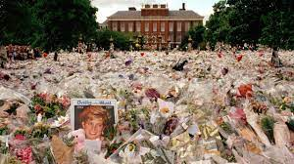
Unfortunately, Diana lost her life in 1997 in Paris because of a car accident
She continued to be estimated and she has become
a symbol of humility and simplicity

Slide 43
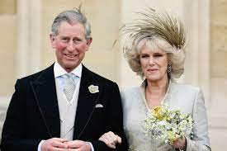
Prince Charles and Camilla
Prince Charles married Camilla Parker Bowles in 2005. The civil ceremony took place at the Guildhall in Windsor, England.
The marriage between Prince Charles and Camilla Parker Bowles came after years of public interest and speculation regarding their relationship, which began in the 1970s.

Slide 44
Golden, Diamond and Platinum Jubilees
In 2002, Queen Elizabeth marked her 50th anniversary of accession → Golden Jubilee
In 2012, Queen Elizabeth celebrated her 60 years on the throne → Diamond Jubilee
In 2022, Queen Elizabeth celebrated her 70th anniversary of accession → Platinum Jubilee

Slide 45
Brexit
In 2016, the UK held a referendum to establish if to remain or leave the European Union
51,9% voted in favour of leaving the EU
Nowadays, European people need a passport to travel in the UK; next year, a travel authorisation will probably also be required.

Slide 46
Death of Queen Elizabeth
On 8th September 2022, Queen Elizabeth II, the UK's longest-serving monarch, died at age 96, after reigning for 70 years
She died in her estate in Balmoral, Scotland
On the 19th September 2022, the funeral took place in Westminster Abbey; the Queen was buried with her husband Philip in the King George VI Memorial Chapel in the Windsor Castle

Slide 47
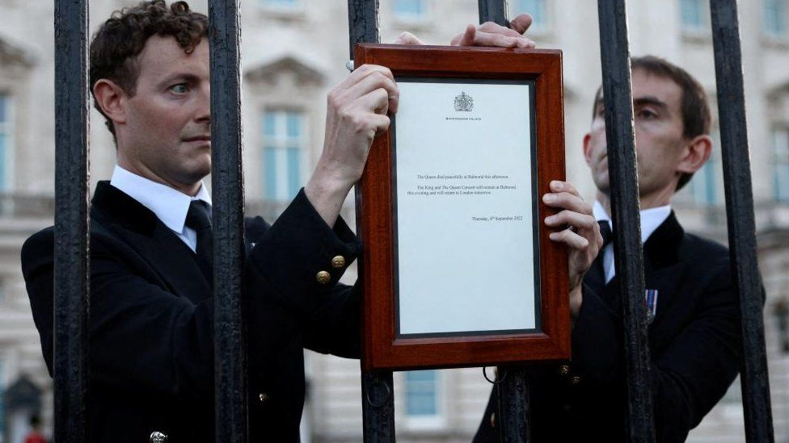
Officials attaching the document in which was written about the death of Queen Elizabeth II

